Slide 1
Digital Business and E-Commerce Management
Lesson 12
Setting a Wix Site Part 3

Slide 2
Setting a Wix Site Part 3
At the end of this lesson, you will be able to
Get familiar with the Wix Dashboard
Add functionality via Wix App
Understand the pricing plan
Publish the site

Slide 3
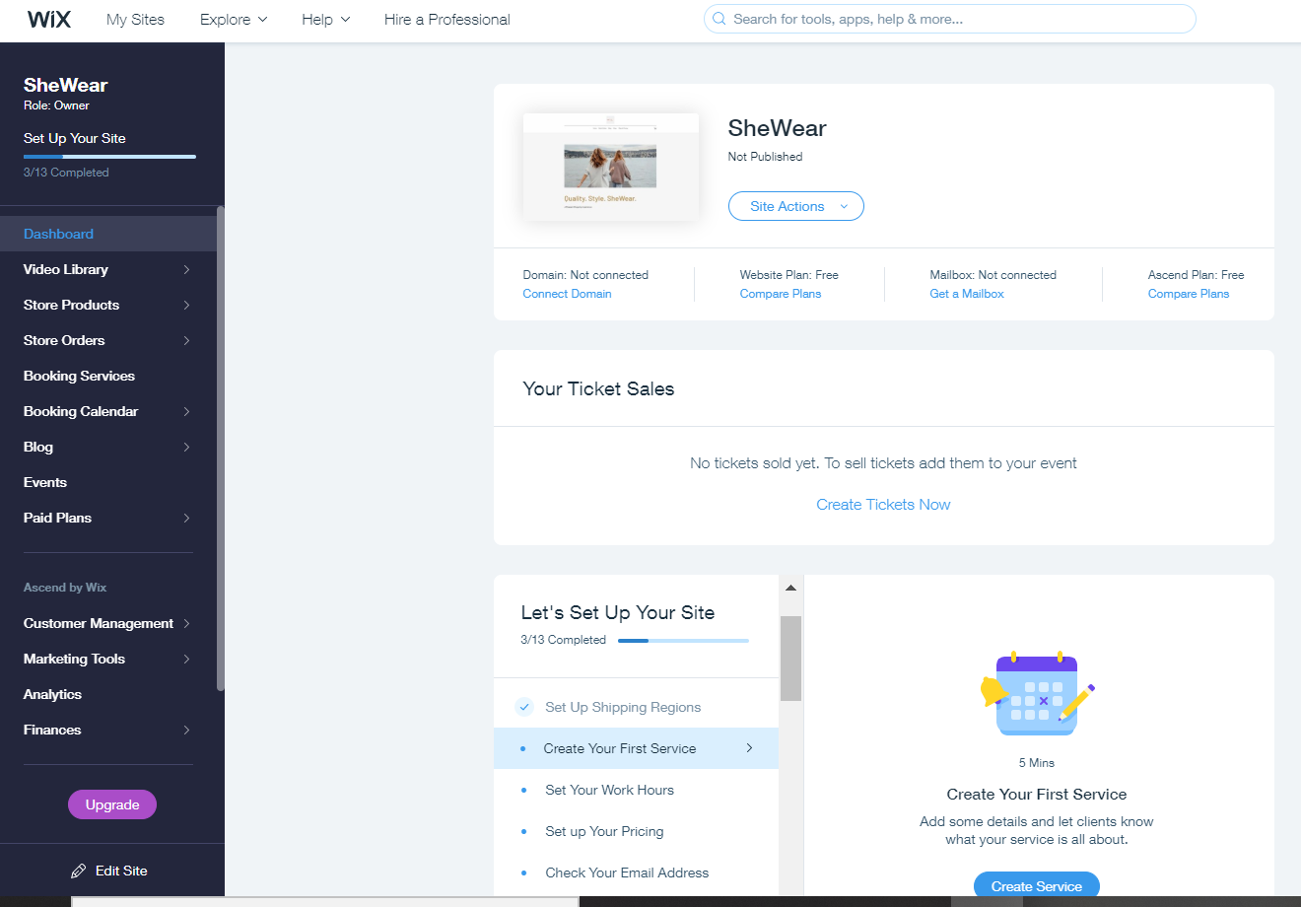
The Wix Dashboard
The primary sidebar where you can quickly access the individual areas of your website.
The main control panel of your website. This is where you can choose from a selection of actions to perform on your site.
A getting-started walk-through. Follow these steps to make sure your site is 100% ready to be seen by people.
(B)
(C)
(A)

Slide 4
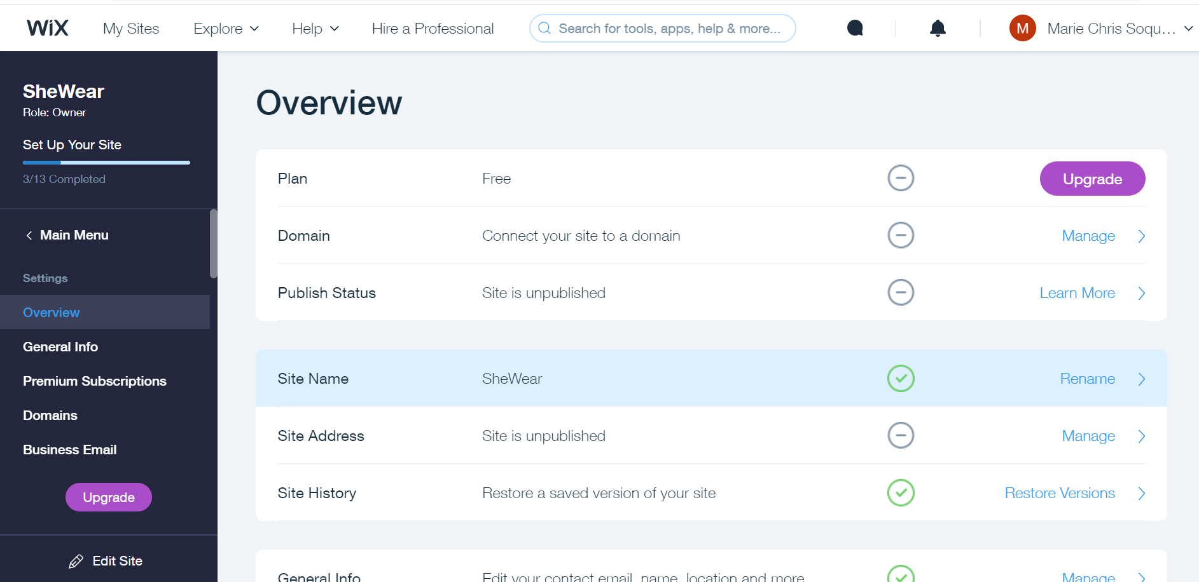
The Wix Dashboard
This is where you can find all the key settings of your site, such as the name, general info, integrations with other tools, payment options, currency, and a lot more.

Slide 5
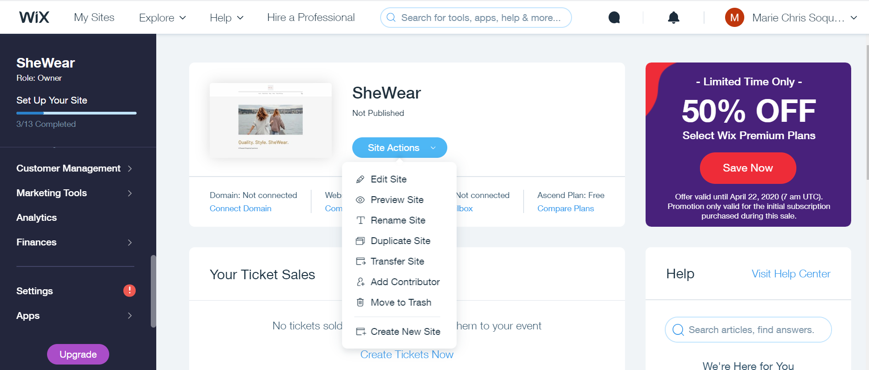
The Wix Dashboard
This is where you select what actions you want to perform with your Wix site. In your Wix dashboard you create 1 or more sites and manage it individually

Slide 6
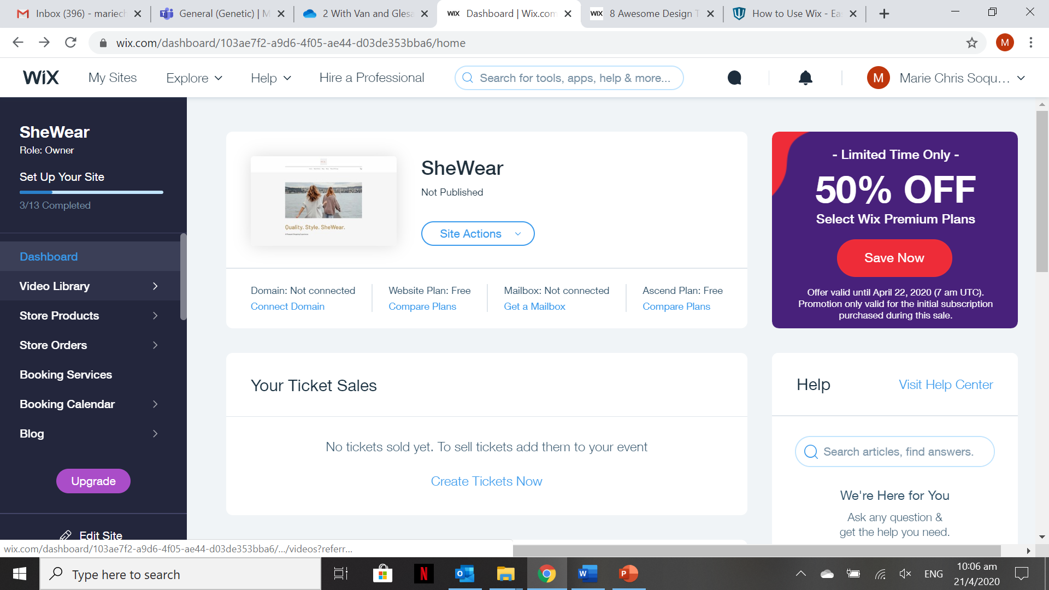
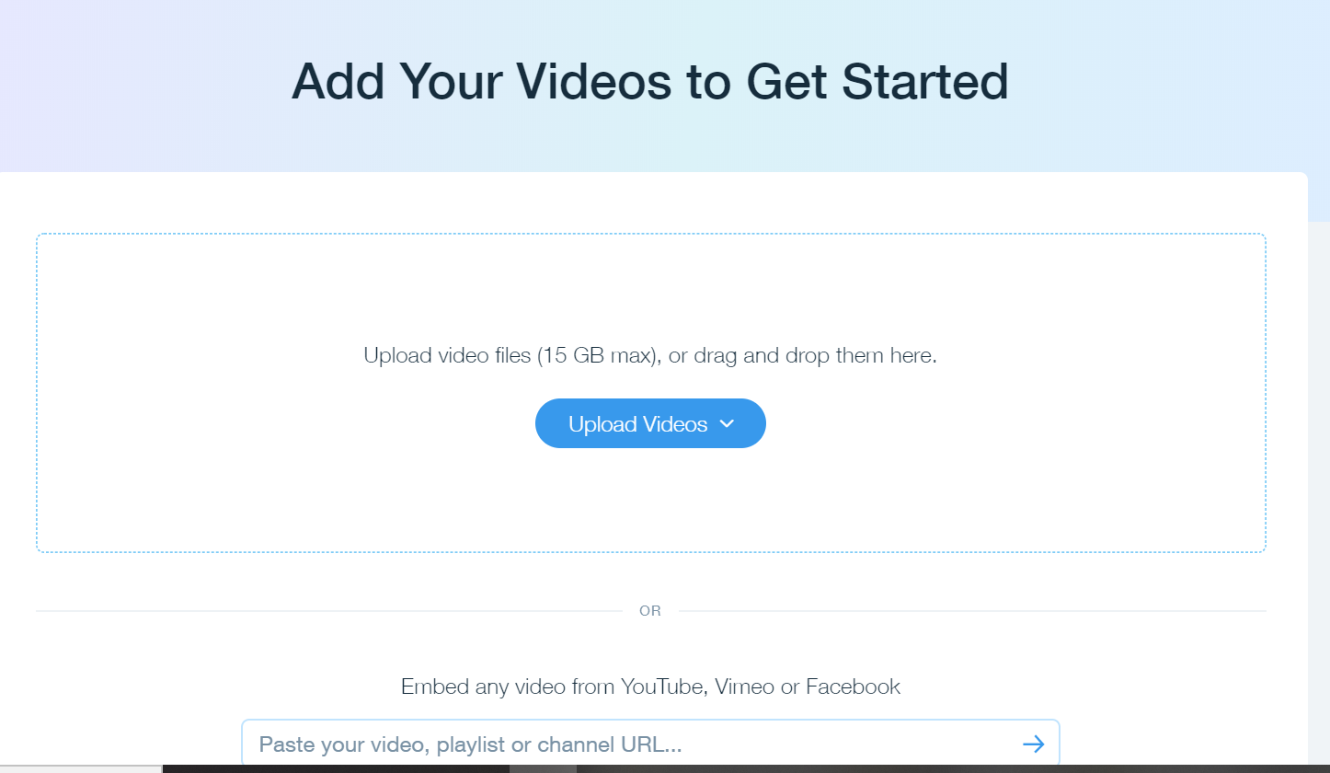
The Wix Dashboard
You can upload videos and embed any videos from YouTube & etc. Videos can be used for promotional and branding purposes.

Slide 7
Activity 12.1
Refer to your book for Activity 12.1

Slide 8
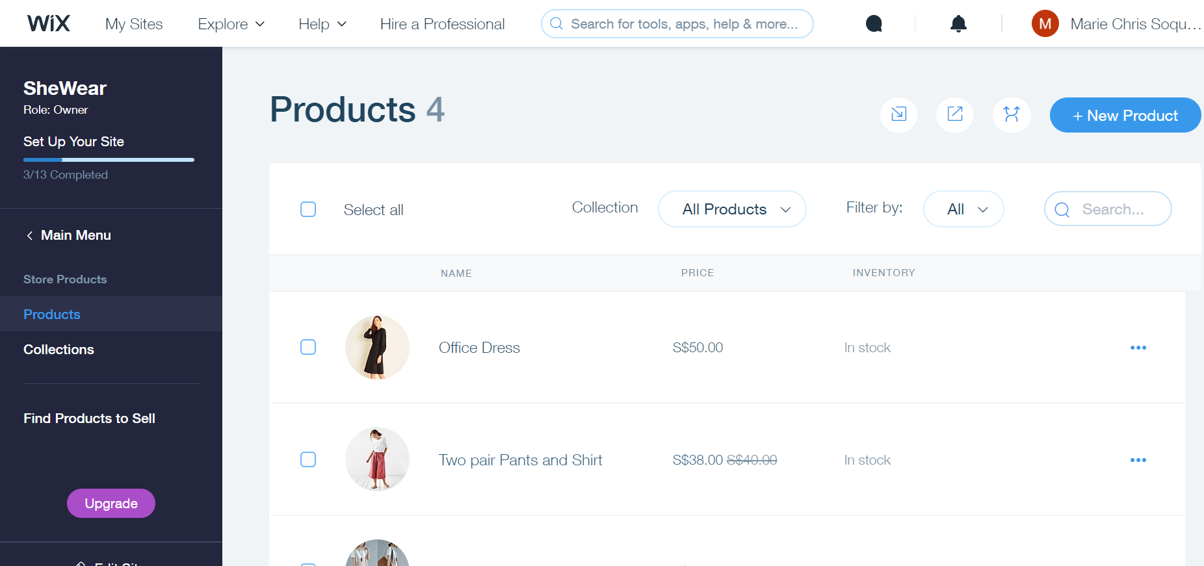
The Wix Dashboard
This section is where you can manage products, create collections/categories of products

Slide 9
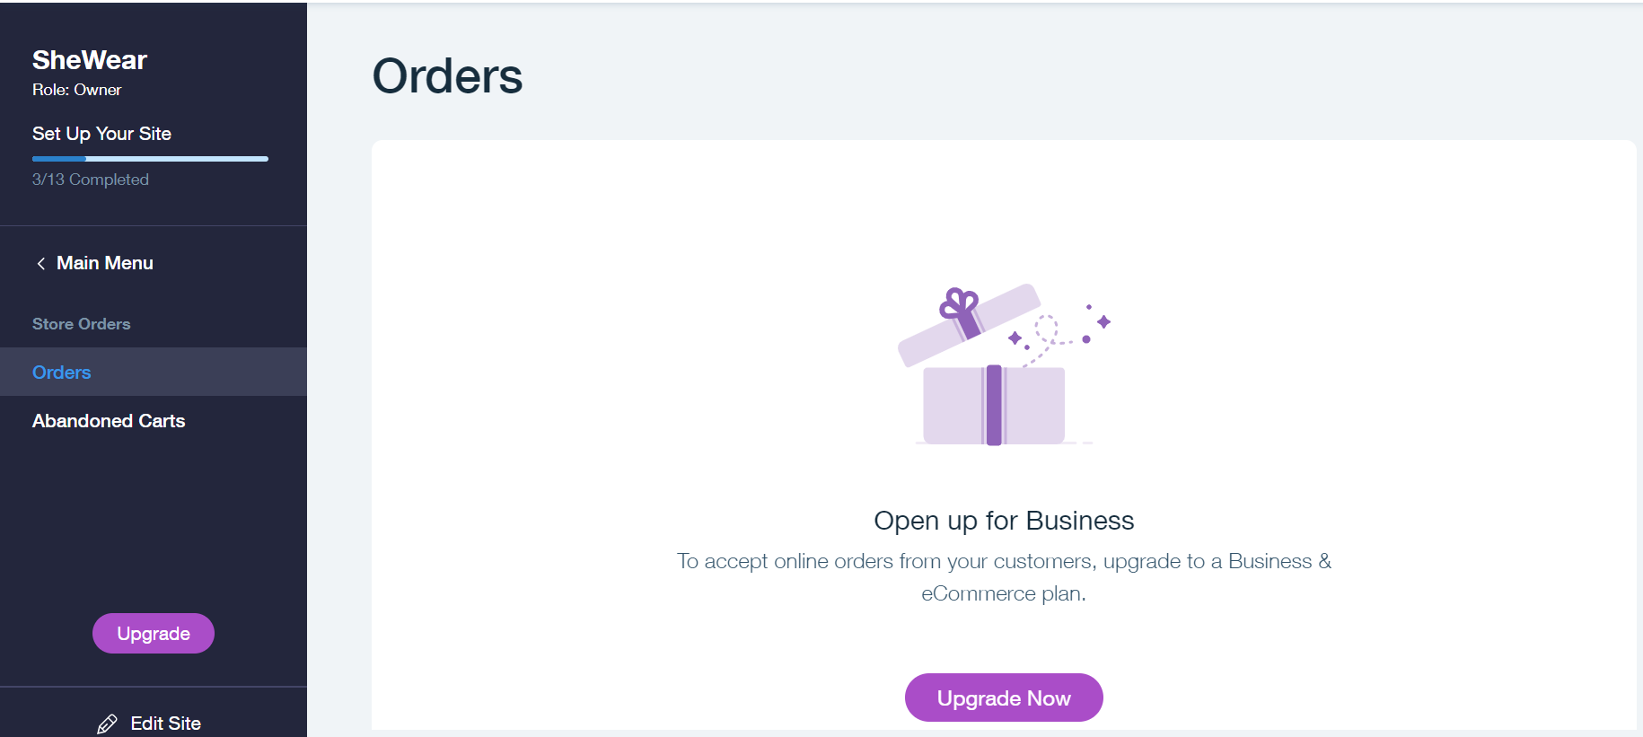
The Wix Dashboard
This section is where you can view all the orders you received from your online store. But you do need to upgrade your Wix Plan to allow complete online order process.

Slide 10
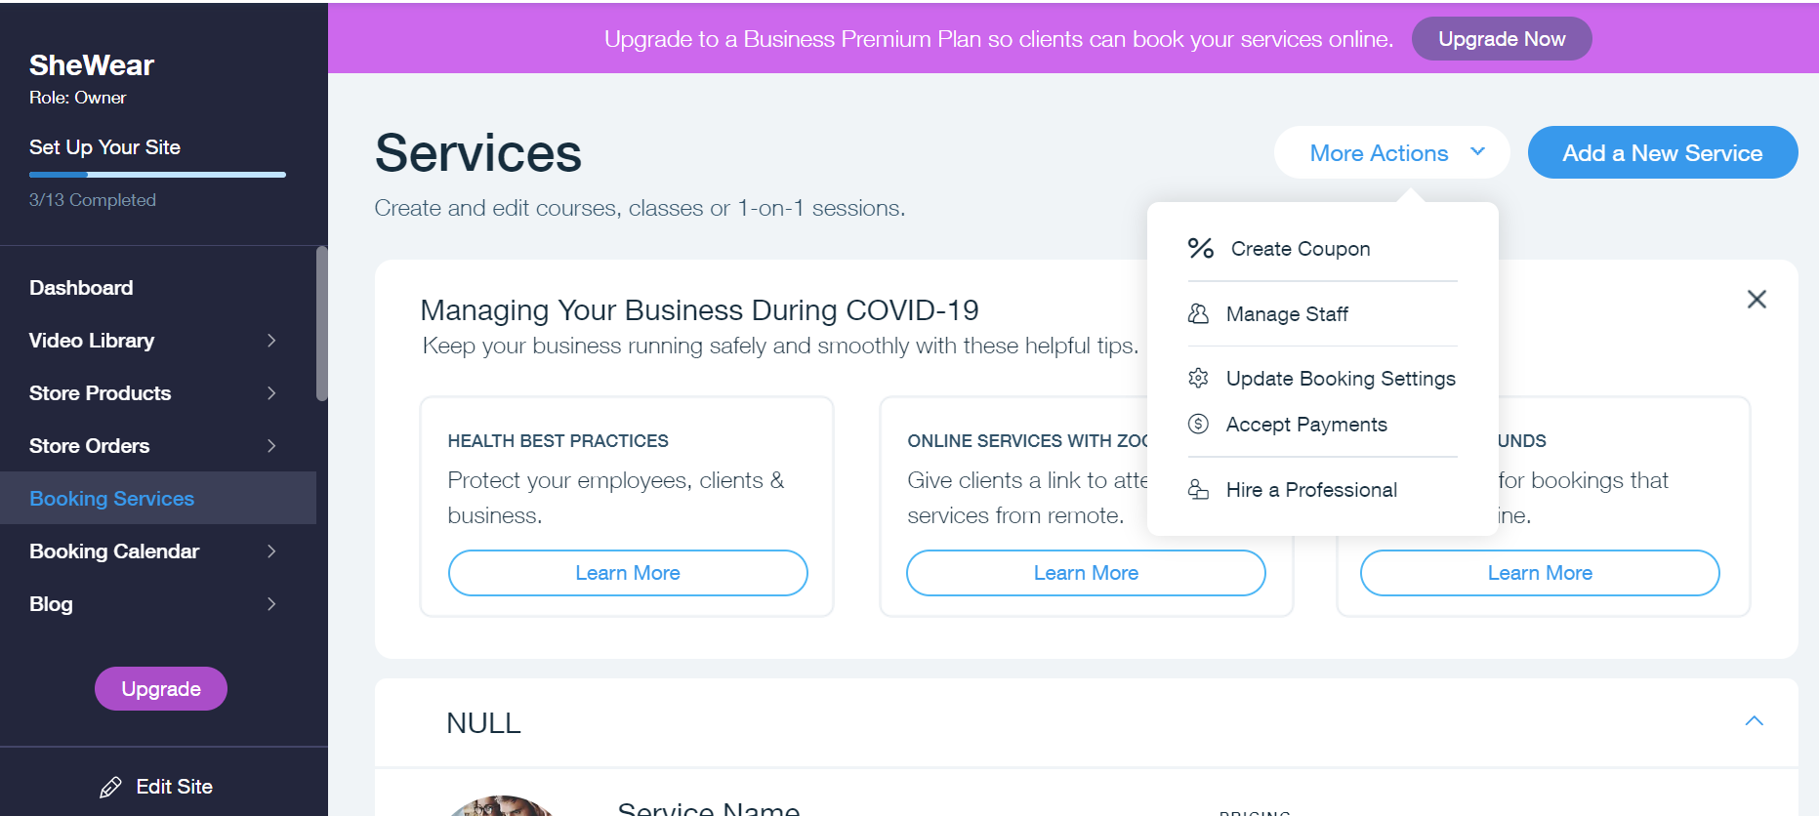
The Wix Dashboard
If the company or providing services, this is the section where you can add and manage the services items.

Slide 11
Activity 12.2
Refer to your book for Activity 12.2

Slide 12
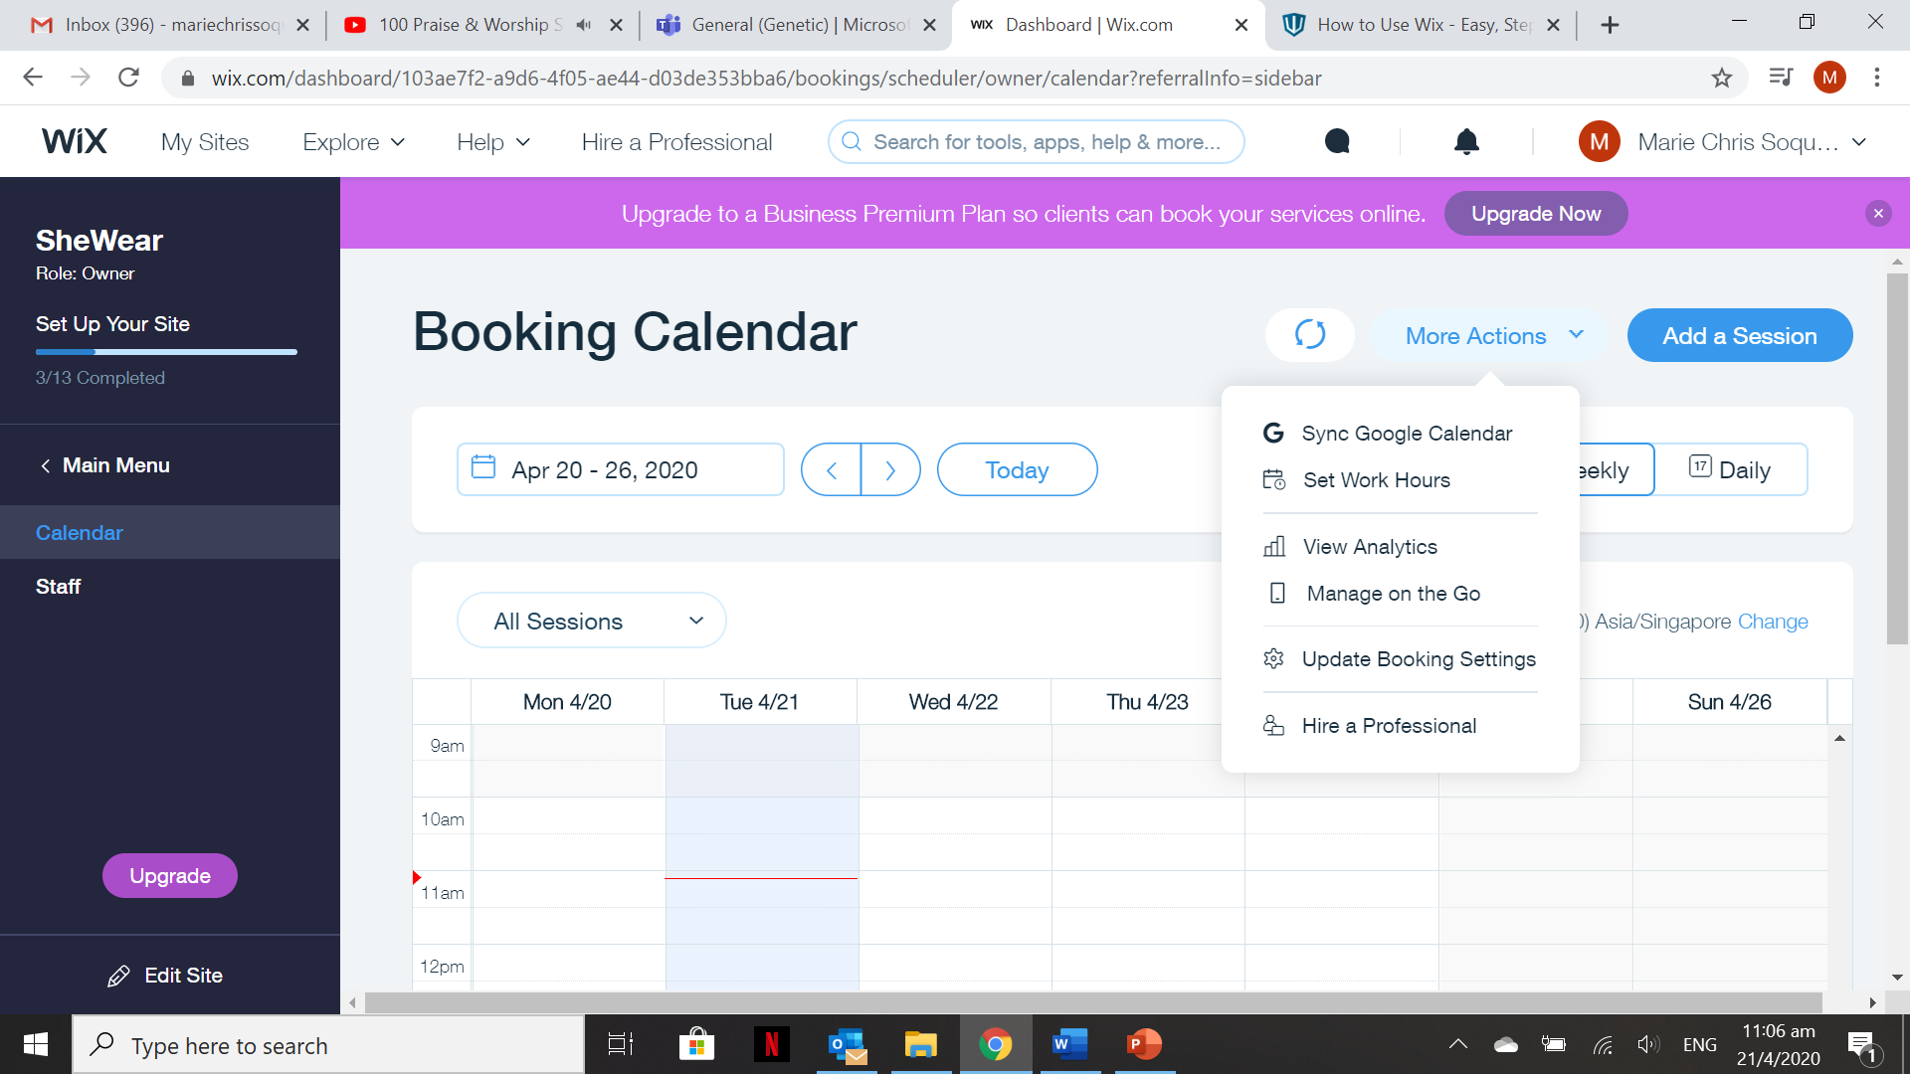
The Wix Dashboard
It is where you manage the booking of services dates. There are several things you can do with the booking calendar like syncing it Google Calendar, Analytics & etc.

Slide 13
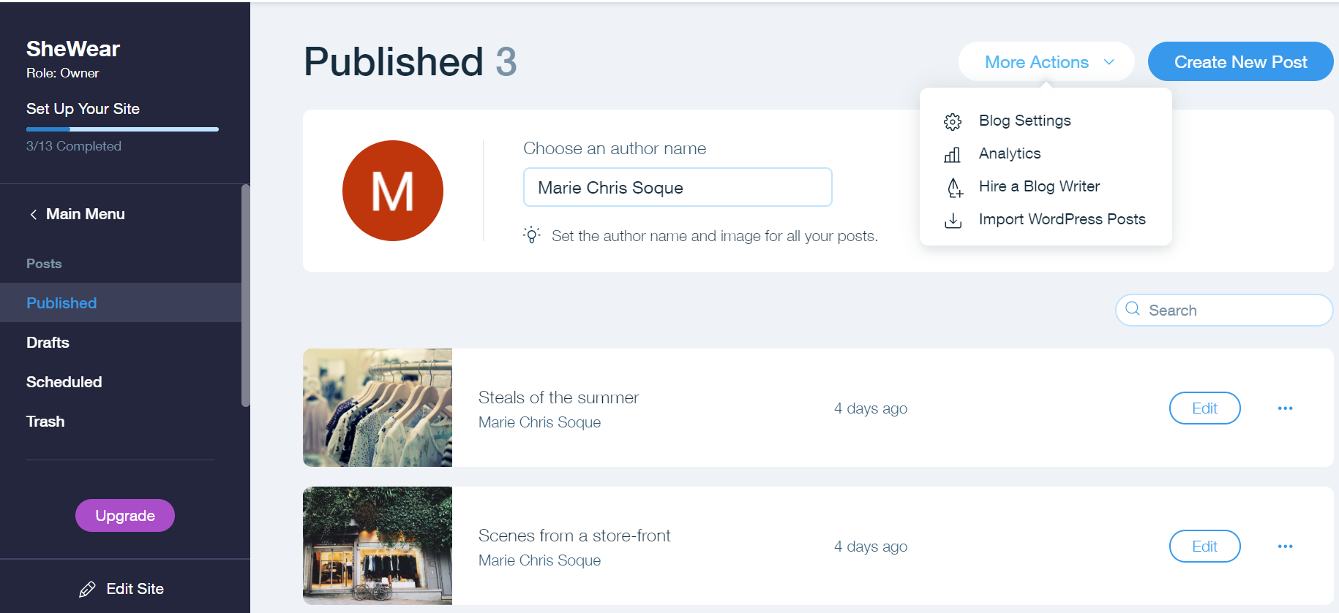
The Wix Dashboard
This section is where you can add and manage blog posts.

Slide 14
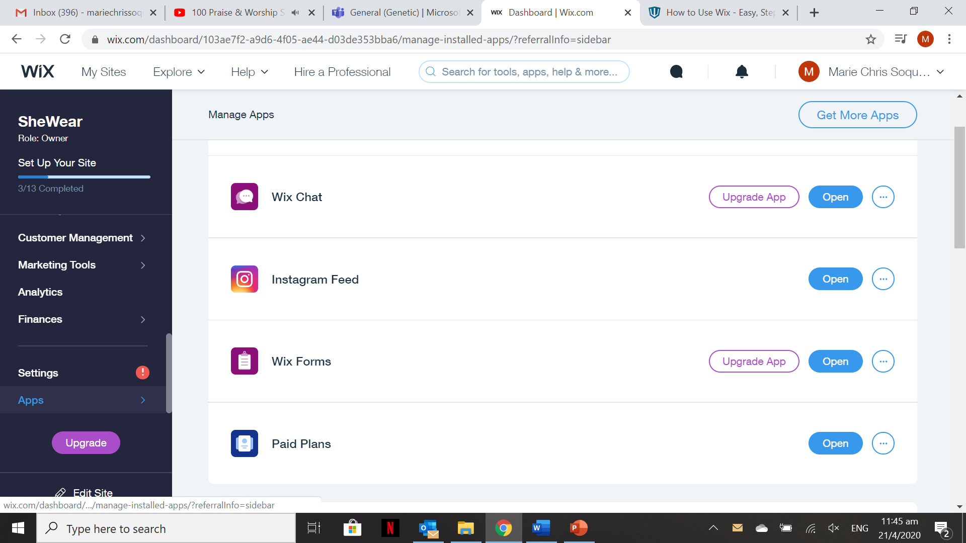
Add Functionality via Wix App
If the features you get from Wix out the box are not enough, you can take a look into the Wix App Market. You’ll find more than 200 different apps there to help you build and grow your website.

Slide 15
Activity 12.3
Refer to your book for Activity 12.3

Slide 16
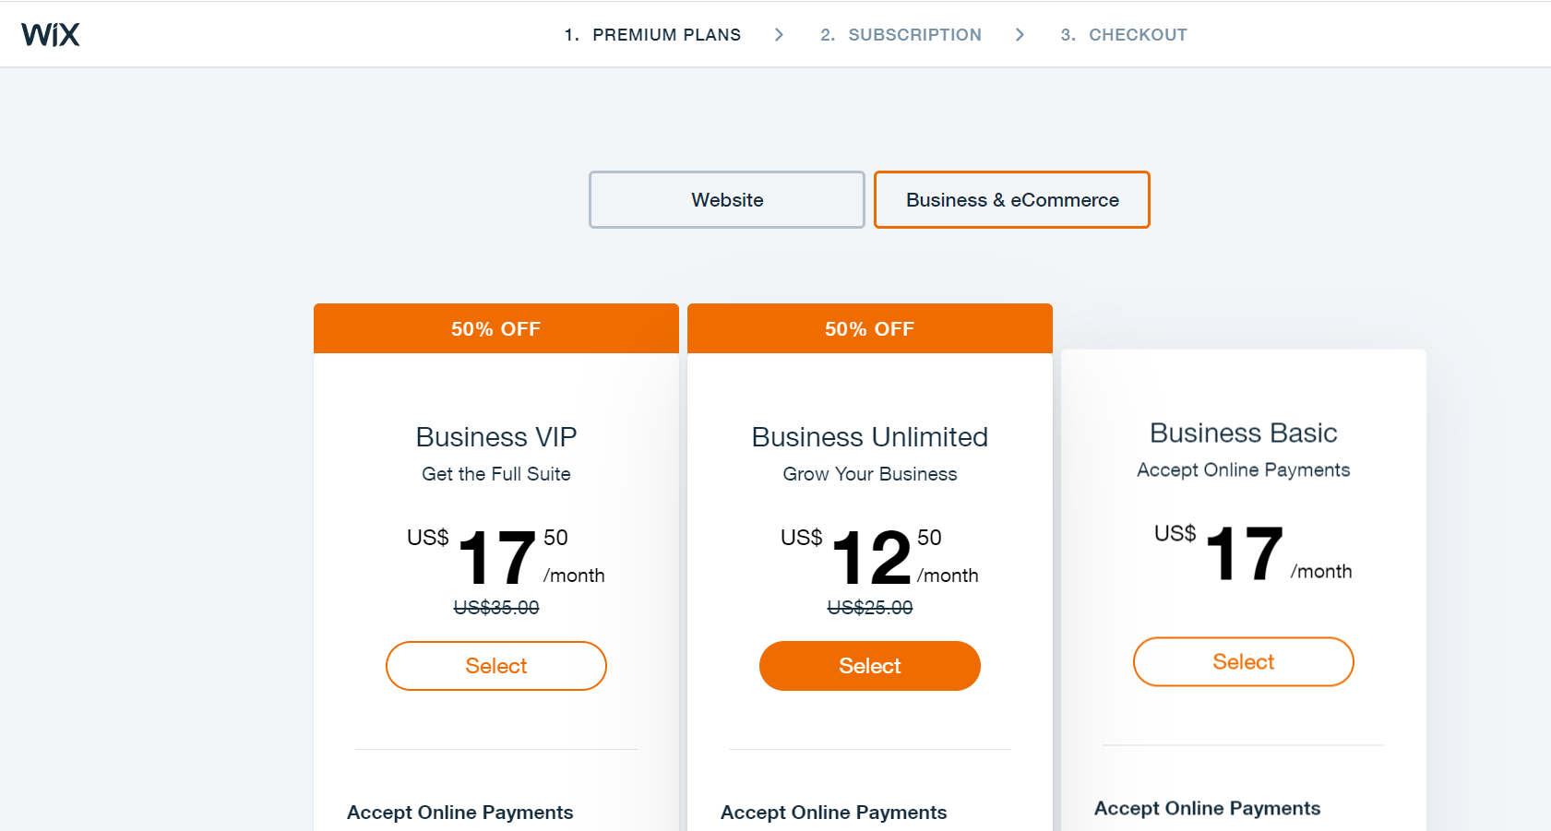
Wix Pricing Plans

Slide 17
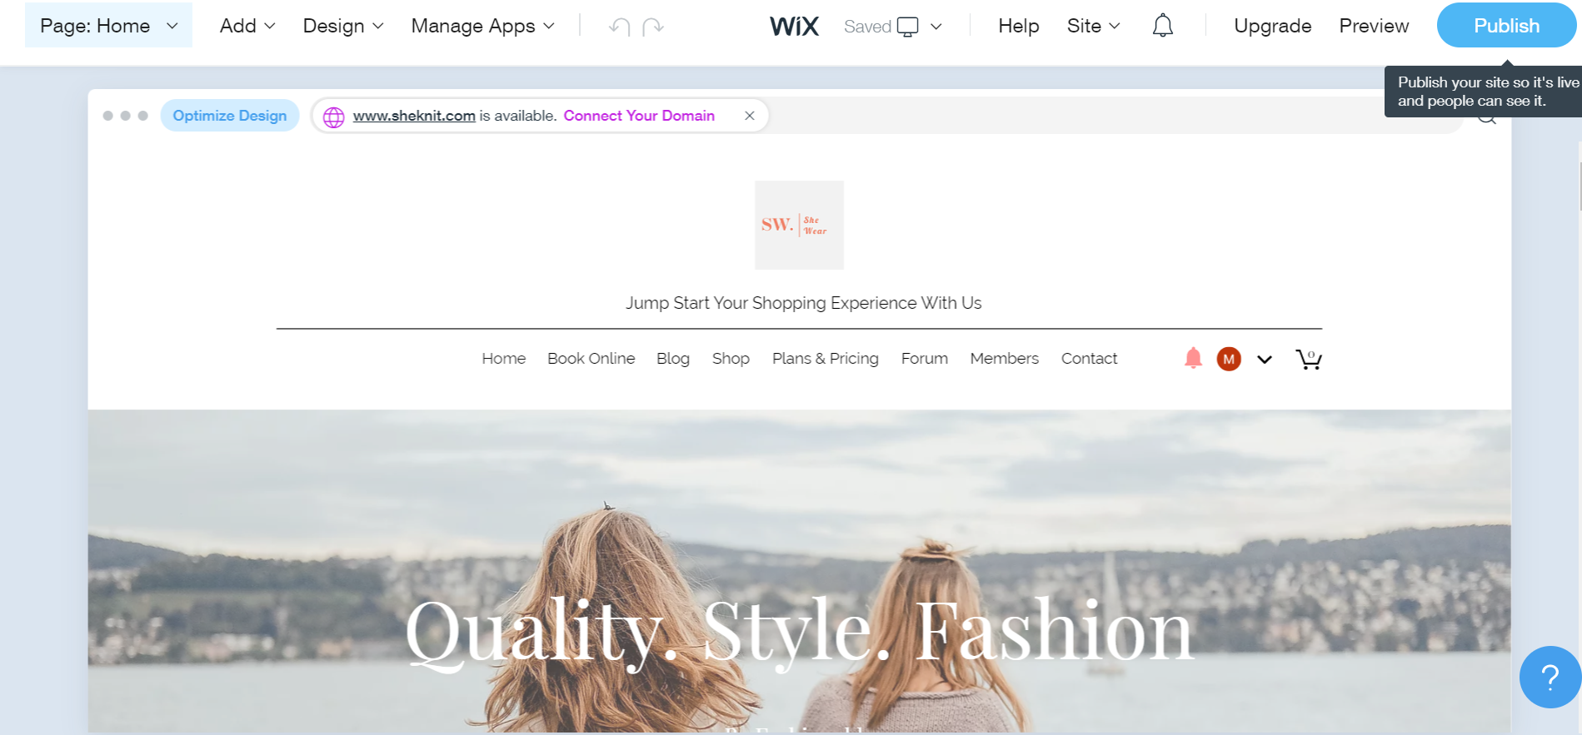
Publishing the site
Click this button to start publishing your site so that it becomes live and people can start seeing your site.

Slide 18
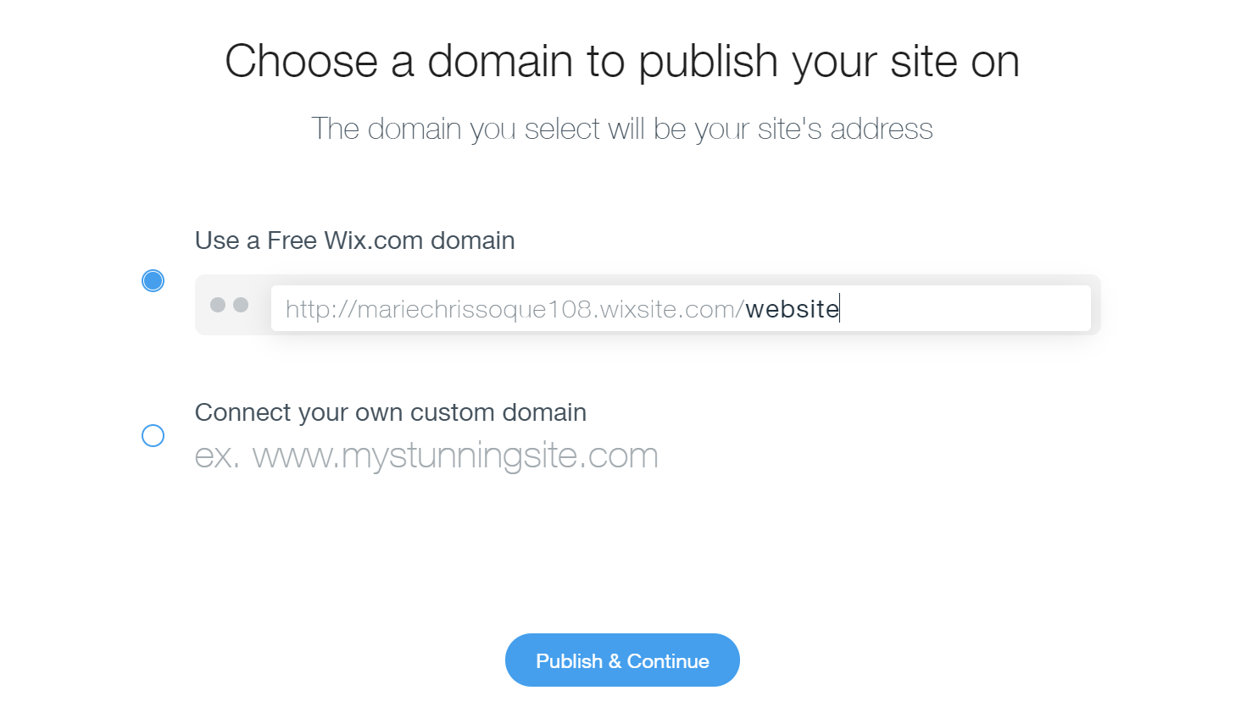
Publishing the site
You need to choose whether you want to use a Free Wix.com domain or connect to your own custom name.

Slide 19
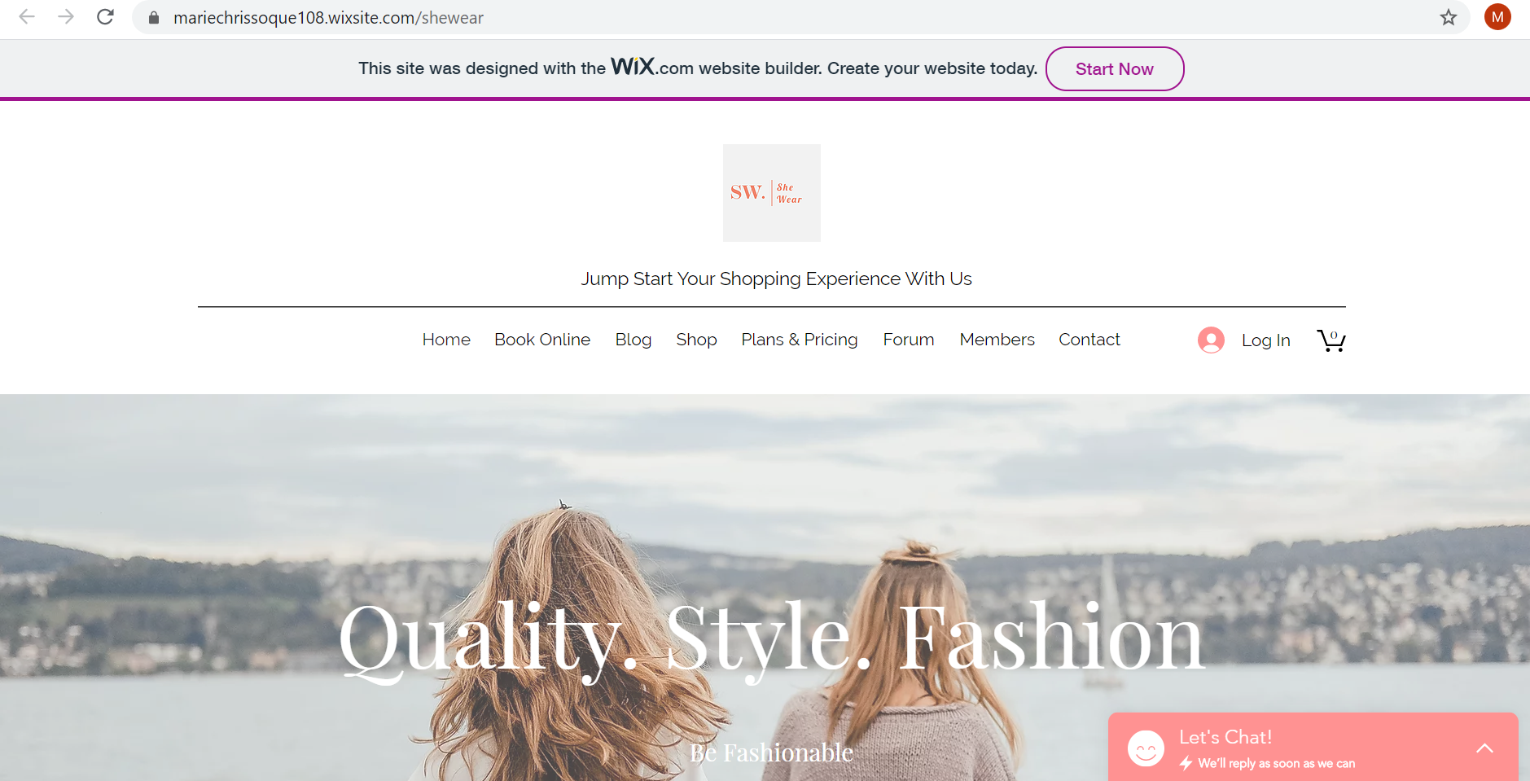
Publishing the site

Slide 20
Activity 12.4
Refer to your book for Activity 12.4

Slide 21
Portfolio – Wix Dashboard
The contents of your portfolio for this lesson are the following:
Upload a promotional video for branding purposes in your video library.
Created one simple service
Installed and added one free App in your Wix site
Published site with a free Wix domain name

